Slide 1
Toxicology course
Part 4:
Household products
Pesticides
TOXICOLOGY

Slide 2
Household products

Slide 3
Any chemical / mixture that may be harmful to the environment and to human health if inhaled swallowed or absorbed through skin.
These toxic substance contained in everyday household products.
Poisoning due to household substances is usually mild.

Slide 4
Drugs and household cleaners are the most reported cases of poisoning.
Easy availability of household product makes them one of the leading causes of poisoning.
Usually target age: under the age of five, majority were children between the age of 1-3 years.

Slide 5
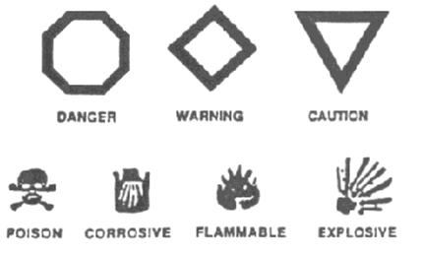
Product warning label indicates level of toxicity
No label = LD50 > 5 g/kg
Caution = 0.5 – 5 g/kg
Warning = 50 – 500 mg/kg
Danger: Poison = <50 mg/kg

Slide 6
Commonly used harmful household products
Cleaners:
Used to remove dirt mostly contains fragrance, surfactants & pesticides.
Surfactants remove dirt & pesticides kill germ like bacteria and viruses.
Glass cleaners – Ammonia, Isopropanol
Dish washers – Cationic, anionic or nonionic detergents
Oven cleaners – Lye (Na/K hydroxide)
All purpose cleaners – Ethylene glycol, Na hyperchlorite

Slide 7
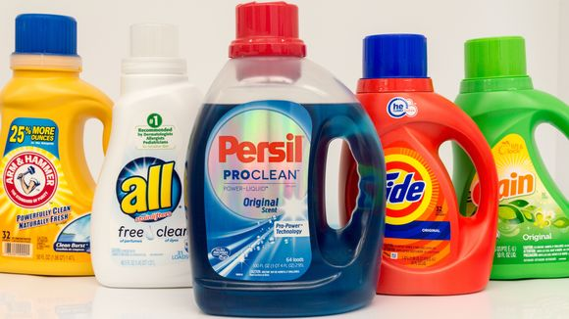
Soaps, Shampoos, Detergents:
Most have low toxicity, Usually cause only vomiting and diarrhea
Cationic surfactants are found in contact lens solutions, fabric softeners: can cause neuromuscular and ganglionic blockade as well as GI ulcerations, acidosis and shock
Anionic surfactants are in many cleaning products like shampoos have the potential to cause hemolysis

Slide 8
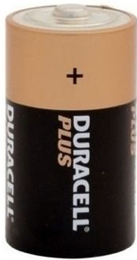
Rust removers:
Mold and rust are kind of funguses.
Pesticide chemicals found in these products are chlorine, alkyl ammonium chloride.
Very caustic and corrosive.
Batteries:
Dry cell – Carbon + Heavy metal
Wet cell – used for vehicles, lead and battery acid(H₂SO₄)

Slide 9
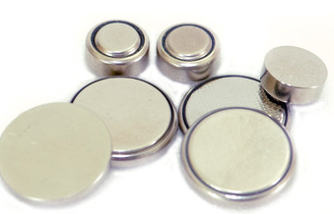
Button & Disk Batteries:
Button/Disk battery single cell batteries used as an energy source for digital watches, calculators, cameras etc.
Contains heavy metals and potassium oxide solution.
If swallowed – majority no symptoms passed intact with feces.
If impacted in esophagus – fever, dysphasia, vomiting and anorexia
Tissue damage cause by flow of electric current, potentially fatal.

Slide 10
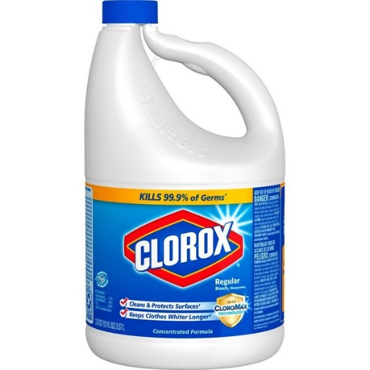
Bleaches/ Disinfectants:
Used to kill germs
Depending on the specific product usually do not cause serious harm if a small amount is swallowed.
Average amount may cause serious poisoning and even death.
Germicide chemical-acids, alkalis, pine oil, phenol.....

Slide 11
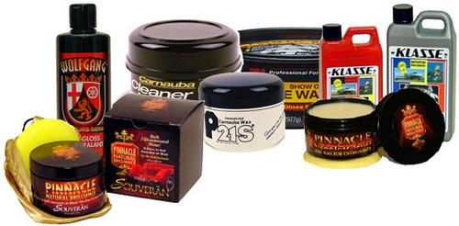
Paints/ Polishes
Paints:
Water base - mostly used for indoors. Main solvent is water
Oil base – mineral spirit and other petroleum distillate. Used for out doors.
Polishes: Furniture polishes & metal cleaners – petroleum distillate.

Slide 12
Treating Household Cleaner Ingestions
If a potentially toxic amount of a non-corrosive compound ingested, emesis should be induced; no activated charcoal unless systemic effects are expected
For corrosive compounds:
dilute with milk or water
determine exactly how much of what material was ingested

Slide 13
Treating Toxic Corrosive Ingestions
If there is pain, dysphagia, excessive drooling, or ulceration and the exposure was potentially toxic:
Establish airway and get esophagoscopy
If esophagus can’t be examined quickly, start corticosteroids
Symptomatic and supportive care

Slide 14
Petroleum Products
Gasoline, mineral spirits, kerosene, lighter fluid, nail polish remover, solvents, motor oil, furniture polish, Break fluid, car coolant, antifreezer.
Biggest worry is aspiration causing hydrocarbon pneumonia
Pneumonia risk related to viscosity; less viscous = more toxic.
Break fluid, car coolant, antifreezer ethylene glycol, highly toxic – damage to heart, kidney & brain can cause death.
Notes:
White Spirit is a petroleum distillate used as a paint thinner and mild solvent. In industry, mineral spirits are used for cleaning and degreasing machine tools and parts, and in conjunction with cutting oil as a thread cutting and reaming lubricant.

Slide 15
Systemic Toxicity of Hydrocarbons
Most hydrocarbons are CNS depressants
Some volatile hydrocarbons sensitize the heart to catecholamines and can cause sudden death due to cardiac arrest
Many hydrocarbons cause dermal irritation and hair loss

Slide 16
Signs of Hydrocarbon Toxicity
CNS: Depression, lethargy, ataxia, seizures, coma
Respiratory: Dyspnea, coughing, wheezing, X-ray changes in lungs with pneumonia
Spontaneous vomiting and aspiration often occurs with more volatile compounds

Slide 17
Treating Hydrocarbon Ingestions
Wash for dermal exposures
Do not try to increase viscosity by adding heavier compound
Do not induce emesis unless a large, life threatening ingestion (>1 ml/kg)
Monitor for pneumonia; treat with antibiotics if present

Slide 18
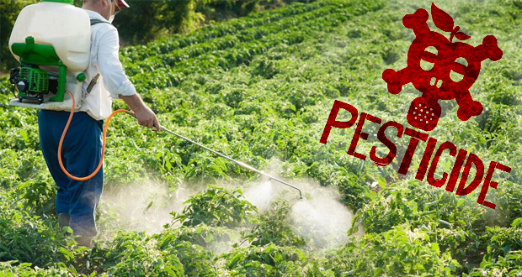
Pesticides

Slide 19
As any substance or mixture of substances intended for preventing, destroying, repelling, or mitigating pests.
Pests can be insects, rodents, weeds, and a host of other unwanted organisms.
About 800 compounds of active ingredients of pesticides have been registered world-wide.
Most pesticides are not highly selective, but are generally toxic to many non target species

Slide 20
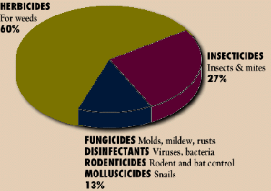
there are a sufficient number of nonfatal poisonings from general pesticide use, averaging about 5000 cases annually in the United States.
The four major classes:
Insecticides (insects)
Herbicides (weeds)
Fungicides (fungi, molds)
Rodenticides (rodents)
Texas center

Slide 21
Groups of pesticides include:
Organochlorine pesticides
Organophosphates
Carbamate pesticides
Pyrethroids
Phenoxyacetic acid – based pesticides
Urea – based pesticides
Diazine and triazine pesticides
Bipyridil – based pesticides
Phenylpyrazoles
Metal – based pesticides
With each class, there is several subclasses exist:
Ex: insecticides… organochlorines….. DDT

Slide 22
Exposure to pesticides:
Exposure to pesticides can occur via the oral or dermal routes or by inhalation.
Oral route:
High doses: leading to severe poisoning and death (suicidal intents, or of accidental ingestion)
Chronic low doses: are consumed by the general population as pesticide residues in food, or as contaminants in drinking water

Slide 23
The dermal route:
is believed to offer the greatest potential for exposure for Workers involved in the production, transport, mixing and loading, and application of pesticides, as well as in harvesting of pesticide-sprayed crops, or in case of accidental spillings.
Slow penetration through the tissue and/ or to potential exposure of others, if clothes are not changed and washed on termination of exposure
Respiratory route:
when aerosols or aerial sprayings are used.

Slide 24
Pesticide degradation
the most important factors are light, temperature, photolysis, free radicals produced in photochemical reactions, hydrolysis.
1. phase 2. phase
XH X – OH X – O – conjugate
The final products are inactive and are
excreted.

Slide 25
Acute Toxicity – pesticides
Dermal: skin irritation, reddening, itching
Oral: nausea, muscle twitching, sweating, weakness
Inhalation: burning of throat and lungs, coughing
Eye: temporary or permanent irritation or blindness

Slide 26
Chronic toxicity of pesticides
Cancer
birth defects
infertility or sterility
Impotence
blood disorders (anemia, inability to clot)
brain damage
Paralysis
emphysema, asthma
kidney problems

Slide 27
REMEMBER:
Low-level exposure to chemicals that have potential to cause long- term effects may not cause immediate injury, but repeated exposures can greatly increase the risk of chronic adverse effects.

Slide 28
INSECTICIDES
Are neurotoxicants, and act by poisoning the nervous systems of the target organisms
Insecticides play a most relevant role in the control of insect pests, particularly in developing countries.
The organophosphates, are involved in a great number of human poisonings and deaths each year

Slide 30
1. Organophosphorus Compounds

Slide 31
Insecticides and antiparasitics
Have high acute toxicity, with oral LD 50 values in rat often below 50 mg/kg.
Mechanism of toxicity:
1. inhibition of Acetylcholine esterase enzyme causes accumulation of acetylcholine at cholinergic synapses, with over stimulation of cholinergic receptors of the muscarinic and nicotinic type

Slide 32
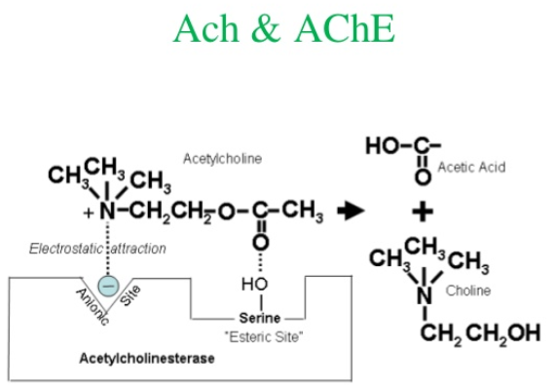

Slide 33
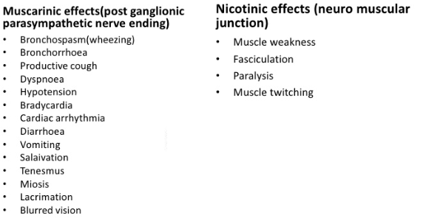
Respiratory failure is a hallmark of severe OP poisoning
The agents are
most rapidly absorbed after inhalation

Slide 34
2. The Intermediate Syndrome:
The syndrome develops one to several days after the poisoning, during recovery from cholinergic manifestations.
weakness of respiratory, neck, and proximal limb muscles. Mortality due to respiratory paralysis and complications ranges from 15% to 40%, and recovery in surviving patients usually takes up to 30 days
There is no specific treatment
Notes:
The hypothesis
that muscle weakness may result from nicotinic receptor desensitization
due to prolonged cholinergic stimulation remains the most
valid (Lotti, 2010). There is no specifi c treatment for the intermediate
syndrome and intervention is exclusively supportive

Slide 35
3. Organophosphate-Induced Delayed Polyneuropathy:
Tingling of the hands and feet, followed by sensory loss, progressive muscle weakness and flaccidity of the distal skeletal muscles of the lower and upper extremities, and ataxia.
These may occur two to three weeks after a single exposure.

Slide 36
Management of organophosphate poisoning
1. check airway, breathing, circulation
2. monitor arterial oxygen saturation, cardiac rhythms, BP, Pulse rate.
3. look for signs & symptoms.
4. obtain IV access.

Slide 37
Treatment of Poisoning:
Dermal : contaminated clothing should be removed, and the skin washed with alkaline soap. rinsing the eyes
Oral: procedures to reduce absorption from the gastrointestinal tract do not appear to be very effective….. give activated charcoal (50 g in 200 ml)

Slide 38
Atropine: it is a muscarinic receptor antagonist, and thus prevents the action of accumulating acetylcholine on these receptors.
Doses of atropine in adults are 1 or 2 to 5 mg in case of mild or moderate poison.
1.8-3.0 mg fast iv bolus-after 3-5minutes check the five parameters of cholinergic poisoning:

Slide 39
Poor air entry into the lungs due to bronchospasm
excessive sweating
bradycardia ( <60 )
hypotension
Miosis
If above parameters are not corrected, double the dose of atropine every 5 minutes until at least 3/5 of below parameters corrected:
clear chest with no wheeze
heart rate 80-100 bpm
systolic BP > 90 mmhg
pupils no longer pinpoint
Higher doses by continuous infusion may be required in severe cases
Atropinization should be maintained for at least 48 hours

Slide 40
Oximes, such as pralidoxime (2-PAM), are also used in the therapy of OP poisoning.
Mechanism of action: 2-PAM contains a positively charged atom capable of attaching to the anionic site of AChE, and facilitates dephosphorylation of the enzyme.
Dosing regimens for various oximes depend on the specific compound and the severity of OP poisoning (30mg/kg loading dose Iv over 10-20mins followed by continuous infusion of 8-10mg/kg/hr until clinical recovery)
Inadequate dosing is major factor for lack of response to oxime therapy and aging of ACh
Notes:
Furthermore, poisoning by OPs bearing
two methoxy groups (malathion, methyl parathion, dimethoate)
is considered to be rather resistant to oxime therapy (Worek et al. ,
1999a). Additionally, time of oxime administration following OP
poisoning is crucial, as their therapeutic window is determined by
the rate of aging. For example, one day after intoxication with a
dimethyl phosphoryl compound, virtually all phosphorylated AChE would be expected to be in the aged form, so that oxime therapy
will be useless by that time (Johnson et al. , 2000). Oximes have
also the potential to form stable phosphoryl oximes that have themselves
anticholinesterase activity; for this reason, and because of
rapid reactivation of carbamylated AChE, oximes are not indicated
in case of poisoning with carbamate insecticides.

Slide 41
Diazepam
(10–20 mg) is also used in the treatment of acute OP poisoning to:
relieve anxiety in mild cases
to reduce muscle fasciculations
antagonize convulsions in the more severe cases

Slide 42
Management of complications
1.Respiratory failure: ET intubation and mechanical ventilation required if - tidal volume <5mm/kg - vital capacity < 15 ml/kg -apnoic spells are present -PaO2 < 08 Kpa& FiO2 > 60%
2.Pulmonary oedema: furosemide 40-80 mg iv
3.convulsion: 5-10 mg iv diazepam
4. ventricular tachycardia: temporary pacing
5. bronchopneumonia: antibiotics & chest physiotherapy

Slide 43
2. Carbamates

Slide 44
Insecticides, herbicides, and fungicides
Ex: Carbofuran: Birds
Exposure: oral and dermal (lower)
Mechanism of action: inhibit AChE
inhibition is transient and rapidly reversible, since there is rapid reactivation of the carbamylated enzyme in the presence of water.
Signs and symptoms: include miosis, urination, diarrhea, salivation, muscle fasciculation, and CNS effects (poor penetration of the blood-brain barrier limits CNS toxicity of carbamates)
The treatment: symptoms relive, the use of the muscarinic antagonist atropine.

Slide 45
3. Pyrethroids
Notes:
For example, the
trans isomer of permethrin is more susceptible to hydrolysis by
CarE than the cis isomer (Soderlund and Casida, 1977; Ross et al. , Type II pyrethroids (see below) are less sensitive to hydrolysis.
For instance, deltamethrin, a type II pyrethroid containing a
cyano group ( Fig. 22-9 ), and present solely as the cis isomer, is
more extensive metabolized by hepatic cytochromes P450, particularly
CYP1A2 and CYP1A1 (Vmax/Km = 34.9), than by liver
CarE (Vmax/Km = 11.5) (Anand et al. , 2006a). Although it has
been suggested that oxidative metabolism may lead in some cases to
bioactivation of certain pyrethroids (Dayal et al. , 2003; Ray and Fry,
2006), the current line of evidence would suggest that hydrolytic
and oxidative metabolism achieve detoxication of the parent, active
compound (Soderlund et al. , 2002). Inhibition of cytochromes P450
by piperonyl butoxide indeed increases pyrethroid toxicity, and so
does inhibition of CarE (Casida et al. , 1983).

Slide 46
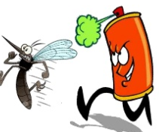
Pyrethroids are used widely as insecticides both in the house and in agriculture
in medicine for the topical treatment of scabies and head lice, and in tropical countries for malaria control, both in soaked bed nets to prevent mosquito bites and in indoor residual spraying.
Values of LD ₅₀ are low: for example, from 100 mg/kg (deltamethrin) to 10,000 mg/kg (phenothrin).

Slide 47
Insecticides and antiparasitics
Toxic for fish and bees
Mechanism of the toxic action -
pyrethroids T (tremor) – contain no α-cyano group
cause reversible block of sodium channels (e.g. permethrin)
pyrethroids CS (choreoatetosis, salivation) – contain α-cyano group
cause reversible block of sodium channels and inhibition of GABA (e.g. deltamethrin)

Slide 48
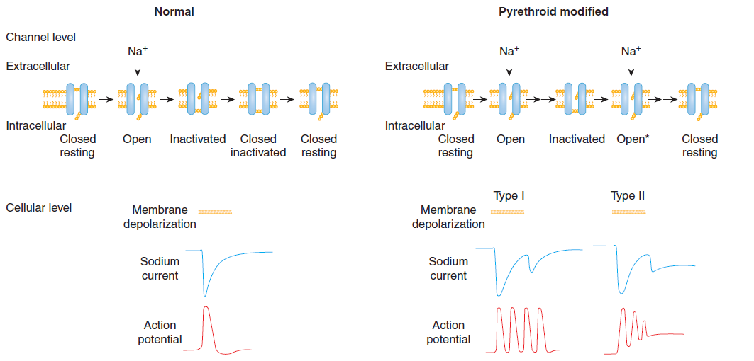

Slide 49
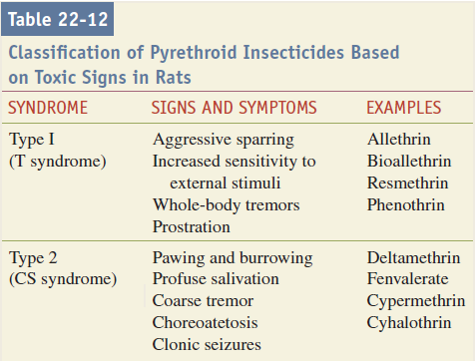
Signs and Symptoms:

Slide 50
4. Organochlorine Compounds (DTT)
in agriculture, structure insect control, and malaria
Their acute toxicity is moderate (less than that of organophosphates), but chronic exposure may be associated with A.E particularly in the liver and the reproductive system..fat soluble
Have been banned in most countries in the past 30 years. Yet, because of their environmental persistence and high lipophilicity, exposure to these compounds continues, most notably through the diet

Slide 51
DDT has a moderate acute toxicity when given by the oral route( with an LD 50 of about 250 mg/kg)
Dermal absorption of DDT is very limited
DDT distributes in all tissues, and the highest concentrations are found in adipose tissue.
Extensively but slowly metabolized.
Symptoms usually appear several hours after exposure, and death, usually due to respiratory failure, may follow after 24 to 72 hours.

Slide 52
Symptoms and signs: nervous system as the primary target
Early:
hyperesthesia of the mouth and lower part of the face, followed by paresthesia of the same area and of the tongue. Dizziness, tremor of the extremities, confusion, and vomiting,
convulsions occur only in severe poisoning.
myocardial arrhythmias

Slide 53
Mechanism of action:
interferes with the sodium channels in the axonal membrane.
inhibits Na + ,K + -ATPase
inhibition of a Ca 2+ -ATPase
alters the levels of some neurotransmitters such as acetylcholine, norepinephrine, and serotonin
OCs alter membrane chloride ion permeability and interfere with normal GABA-ergic (g-aminobutyric acid) neuronal transmission
Notes:
Voltage clamp studies have shown that
the principal effect of DDT is to slow down the closing of sodium
channels once they have opened, while having little or no effect on
closed gates. In addition to this effect on sodium channels, DDT
also affects ATPases. Although DDT inhibits Na + ,K + -ATPase, this
action would not contribute to its neurotoxic effect (Matsumura and
Patil, 1969). Rather, inhibition of a Ca 2+ -ATPase (an ecto-ATPase,
located on the outside of the cell membrane) may be involved in
the effects of DDT. As the function of this Ca 2+ -ATPase is believed
to be that of maintaining high external calcium concentrations, its
inhibition would lower external calcium and contribute to membrane
instability and repetitive fi ring (Matsumura and Ghiasuddin,
1979).

Slide 54
Treatment: acute exposure is rare
Decontamination (gastric lavage, and administration of activated charcoal reduce toxicity after oral ingestion).
supportive treatment
diazepam or phenobarbital may be beneficial to control convulsions, if present.
Myocardial arrhythmias are managed with antiarrhythmics such as lidocaine
Washing of the affected area may reduce absorption after dermal exposure
Chronic exposure: target for DDT is the liver ( increase enzymes levels, cancer)

Slide 55
5. Other Insecticides
Rotenoids:
Used in agriculture, fishing
inhibit the mitochondrial respiratory chain,
symptoms: increased respiratory and cardiac rates, clonic and tonic spasms, and muscular depression, followed by respiratory depression
potential role in the etiology of Parkinson disease
Management of poisoning is supportive and symptomatic.
Notes:
Rotenone is used as an agricultural insecticide/
acaricide, particularly in organic farming (Isman, 2006). It
is rather persistent in food crops after treatment, as indicated by
half-life of four days in olives (Cabras et al. , 2002). Rotenone is
very toxic to fi sh; root extracts were used to paralyze fi sh for capture
and consumption, and rotenone is still used in fi shery management.
In recent years, rotenone has received much attention because
of its potential role in the etiology of Parkinson disease. An earlier
study by Heikkila et al. (1985) showed that stereotaxic administration
to rats of rotenone damaged the dopaminergic nigrostriatal
pathway, similarly to what observed with 1-methyl-4-phenylpyridinium
(MPP + , the active metabolite of 1-methyl-4-phenyl-1,2,3,6-
tetrahydropyridine [MPTP]), a known parkinsonism-causing
chemical, which is also a complex I inhibito

Slide 56
Nicotine: cured and dried leaves of the tobacco plant, Nicotiana
to repel and kill insects, smoke was also used for fumigation.
Mechanism: activating nicotinic acetylcholine receptors
Toxicity: on large amounts (parasympathetic stimulation and ganglionic and neuromuscular blockade)
Symptoms: nausea, vomiting, muscle weakness, respiratory effects, headache, lethargy, and bradycardia or tachycardia.

Slide 57
Convulsions and respiratory paralysis are advanced complications of unattended nicotine toxicity.
Treatment of poisoning:
Symptomatic
decontamination, induction of emesis (depending on the time of onset of symptoms)
maintenance of vital signs.

Slide 58
Metal – based pesticides
arsenic compounds – insecticides, rodenticides
tributyltin – fungicide (xenoestrogenic effect)
thalium compounds – rodenticides
Today
Copper compounds – copper sulphate
– copper oxichloride
fungicides, algicides, molluscocides
Toxicity for fish – LC₅₀ 1 – 10 mg.l⁻¹ depending on water quality

Slide 59
RODENTICIDES
a rodenticide must satisfy several criteria:
the poison must be very effective in the target species once incorporated into bait in small quantity
baits containing the poison must not excite bait shyness, so that the animal will continue to eat it
the manner of death must be such that survivors do not become suspicious of its cause
it should be species-specific, with considerable lower toxicity to other animals

Slide 60
1. Fluoroacetic Acid and Its Derivatives
The main targets of toxicity are the central nervous system and the heart.
Symptoms of toxicity: gastrointestinal symptoms, severe cardiovascular effects (ventricular tachycardia, fibrillation, hypotension), as well as CNS effects (agitation, convulsions, coma)
Treatment:
Monacetin (60% glycerol monoacetate) has proved beneficial in the treatment of poisoned primates
Use of procainamide (for cardiac arrhythmia)
Use of Barbiturates (to control seizures)
Notes:
Fluoroacetate is incorporated
into fl uoracetyl-coenzyme A, which condenses with oxaloacetate
to form fl uorocitrate, which inhibits mitochondrial aconitase. This
results in inhibition of the Krebs cycle, leading to lowered energy
production, reduced oxygen consumption, and reduced cellular
concentration of ATP. Blockage of energy metabolism is believed
to account for most signs of toxicity, although some may be due
to accumulation of citrate, which is a potent chelator of calcium
ions (Pelfrene, 2010). Since 1946, when sodium fl uoroacetate was
introduced in the United States, several cases of human poisoning
have been reported.

Slide 61
2. Anticoagulants
Toxicokinetics
Warfarins are rapidly and completely absorbed, reaching peak plasma concentrations within one hour. In circulation, warfarins are almost completely bound to plasma albumin (97–99%), localize to lipid and protein compartments (Vd ¼ 0.15 L/kg), and have a long half-life (about 35 hr).
Mechansim: Coumarins antagonize the action of vitamin K in the synthesis of clotting factors (factors II, VII, IX, and X)….. Warfarin

Slide 62
Accidental exposure from ingested rodent bait mostly involves children, whereas intentional ingestion is associated with attempted suicides
Symptoms : massive bruises, hematomata, gum and nasal hemorrhage… monitor INR
“second- generation” anticoagulants: “superwarfarins” brodifacoum or difenacoum because of increase of resistance to warfarin.

Slide 63
Clinical Management of Acute Poisoning
Replacement of blood loss, A unit of fresh frozen replenishes lost multiple clotting factors and restores blood volume.
Chronic anticoagulant management necessitates the administration of vitamin K1 (phytonadione).
Subcutaneous or IV administration of this active form of vitamin K rapidly corrects PT within 24 hours. Maintenance with the oral dosage form may be continued for several weeks, as needed.

Slide 64
FUNGICIDES
Are surface or plant protectants, and are applied prior to potential infection by fungal spores.
Many fungicides have low acute toxicity in mammals.

Slide 65
1. Captan and Folpet
chloroalkylthio fungicides: due to the presence of side chains containing chlorine, carbon, and sulfur
low acute oral and dermal toxicity (LD 50 ≅ 5g/kg), while they are very toxic by the i.p. route (LD 50 = 40–50 mg/kg).
They are potent eye irritants, but only mild skin irritants
Both are extensively and rapidly metabolized in mammals
Carcinogenic and reproductive studies

Slide 66
HERBICIDES
are chemicals that are capable of either killing or severely injuring plants.
Mechanism: act at a large number of sites of metabolic functions and energy transfer in plant cells (Inhibition of photosynthesis, Inhibition of respiration, Inhibition of lipid and protein synthesis,
Preplanting herbicides: applied to the soil before a crop is seeded
Preemergent herbicides: applied to the soil before the time of appearance of unwanted vegetation.
Postemergent herbicides: applied to the soil or foliage after the germination of the crop and/or weeds

Slide 67
Herbicides are divided according to the manner they are applied to plants:
Contact herbicides: affect the plant that was treated
Translocated herbicides: applied to the soil or to above-ground parts of the plant, and are absorbed and circulated to distant tissues.
Nonselective herbicides : will kill all vegetation
Selective compounds : used to kill weeds without harming the crops.

Slide 68
Bipyridyl Compounds
Ex: Paraquat
Paraquat has one of the highest acute toxicities among herbicides; its oral LD 50 in rat is approximately 100 mg/kg.
Target of toxicity: lung and kideny
Mechanism of toxicity: form a free radical(redox cycling reactions), mitochondrial damage

Slide 69
Treatment: prevention of absorption from the gastrointestinal tract, prevention of its accumulation in the lung, use of free radical scavengers, and prevention of lung fibrosis
whole-bowel irrigation, forced diuresis and hydration, hemodialysis, hemoperfusion, surgical approaches, radiotherapy.

Slide 70
Ex: Diquat
Lower toxicity
is not carcinogenic in rodents, has no effect on fertility, and is not teratogenic
no lung toxicity
target organs for toxicity are the gastrointestinal tract, the kidney, and particularly the eye.
form a free radical

Slide 71
Symptoms: nausea, vomiting, diarrhea, ulceration of mouth and esophagus, decline of renal functions, and neurologic effects, but no pulmonary Fibrosis
Treatment: preventing absorption and enhancing elimination

Slide 72
References
Toxicology : the basic science of poisons, casarett and doulls, 8 ^{ed} ,2013,unit 1, chapters22,24,32
Clinical toxicology , principles and mechanisms, 2 ed , Frank A. Barile,2010,chapter28,29,30

